Slide 1
Forcemac Hong Kong Limited
Introduction to the Company

Slide 2
Agenda
About Us
Customer & Product Overview
Our Services
Driven Progress
Our Advantages
Conclusion

Slide 3
About Us
China & Hong Kong Based Company
Reliable Supplier from the production stages till the delivery
Focuses on Const. Mach. Spare Parts and Auto&Truck Spare parts as well as Auto Electronics;
Overseas Business
demand
supply
FORCEMAC is your gateway to the world …

Slide 4
About Us
Industries that we are active;
Spare Parts
Renewable Energy
Auto Electronics
Tires
Consumer Electronics
Logistics
2016 (March 2015- March 2016)
Total Revenue $5.8 Million USD
China Representative Office; 6 people
Hong Kong Warehouse
Kenya Sales Office; 2 people

Slide 5
Our Services
Value Propositions
Sourcing & Research
Enhancing global efficiencies by providing large scale of products and services.
Solutions with skilled labor, low cost raw material and advantages on other economic factors like tax breaks and low trade tariffs.
Factory Visits Before Order
Face to face contact with dealers
Deepened relations between supply and demand
Real time information available
Notifications and reminders
Report
Technical analysis of factory and production stages
Quality control and testing
Product portfolio research
Reference check
Ordering
Quotations
Dealing about the price and quantity
Delivery details
On-time schedule
Daily follow-ups order process.
Inspection& Shipment
Close tracking of end products after production
Uninterrupted flow of information about the shipment
Railway, air cargo, ocean freight shipments available upon customer preferences and regulation
Custom Clearence
Documentation required by the customs
Warranty on custom inspections

Slide 7
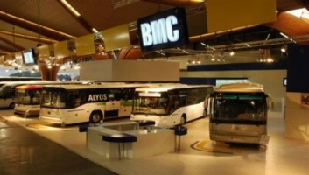
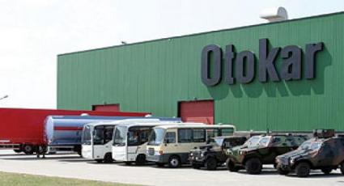
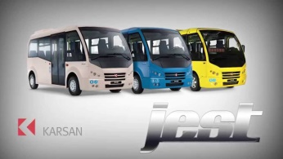
Customer Overview
Cooperate Construction Companies
Reseller & Factory & Aftersales

Slide 8
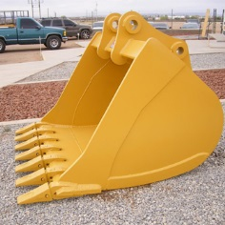
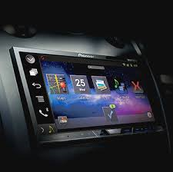
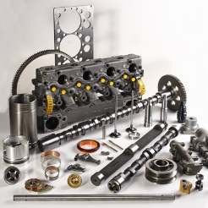
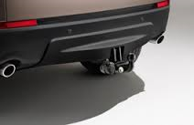
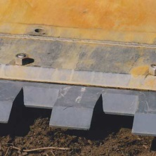
Product Overview
Auto Truck Spare Parts
Construction Machinery Spare Parts
GET Spare Parts
Undercarriage Parts
Buckets
Hardware
Audio & Electronics
Carrying & Towing
Engine Parts
Body Parts
Exterior
Interior

Slide 9
Driven Progress (2016)
Product Range Expansion
New Service Model
Bus Wifi & Announcement systems for Otokar and Karsan
Winter Tyres
Lane Departure Warning System
Guiding
Principles &
Success Factors
of Customer
Satisfaction
Forceget has been launched and started NICHE concept of purchase.
(Beta Version : http://berkin5.wix.com/forceget)
New Expo
MINE Expo btw 26-28 September at Las Vegas
Exhibit in Bauma Shanghai in World`s Largest Constr. Mach. Expo
Automechanica in December at Shanghai
New Marketing Strategies
We have allocated a budget for marketing issues.
New customer acquisition is targeted.
Reaching out new markets with new channels.
Warehouse
Hong Kong warehouse is rented for fast running products.

Slide 10
Our Advantages
Global Company
Customer Care
International Service Standard
International Cooperate Background
Foreign Management Team with better understanding of customer needs.
Cost & time efficiency in local trade. Samples, factory visit, order follow up, organizing shipments
Inspections & feedbacks
Extensive Communication
Feedback
Communication Skills; Chinese, Cantonese, Turkish, English, Russian even French
Understanding local market includes S.Korea, Taiwan, China, HK and create customer friendly solutions.
Auditing reports for specific products.
Label check, testing, test report checking.

Slide 11
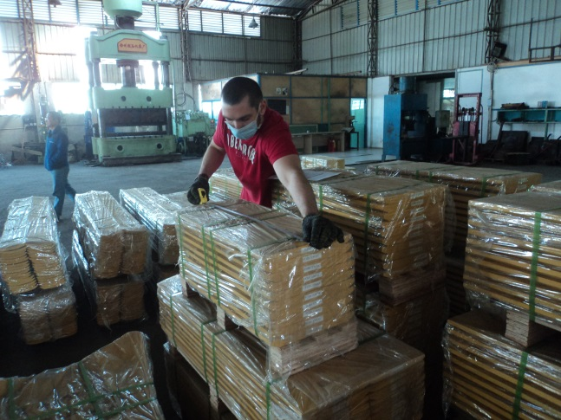
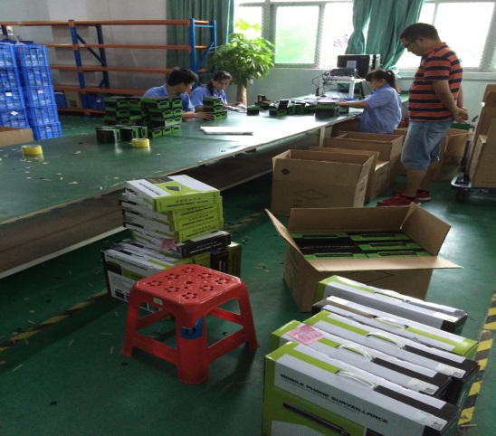
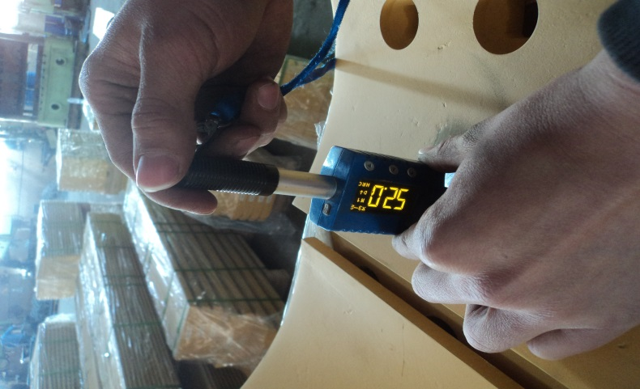
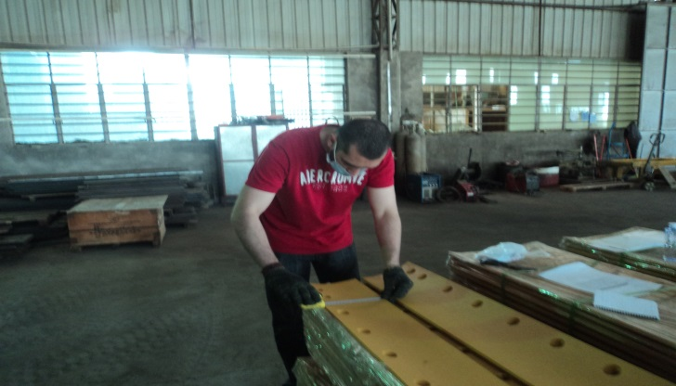
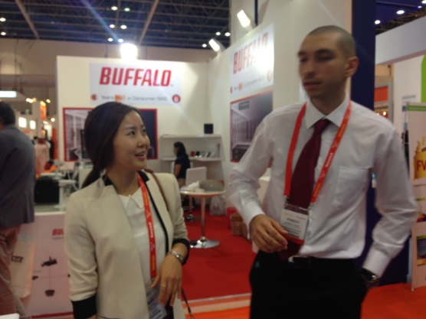
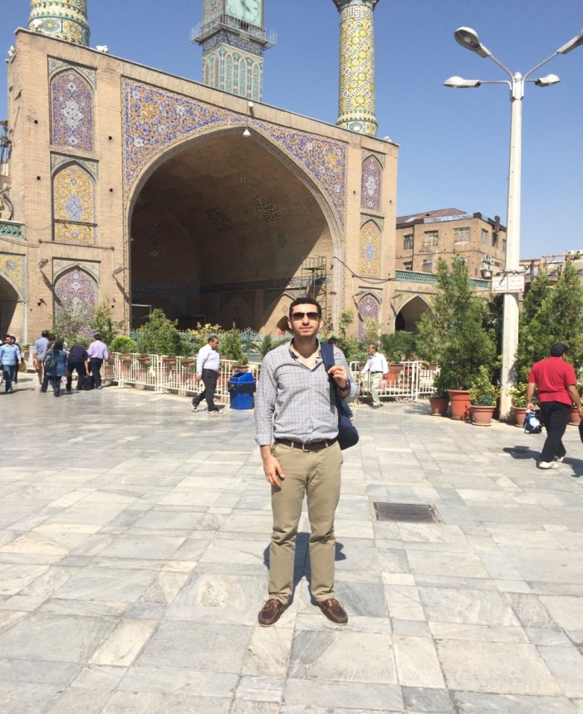
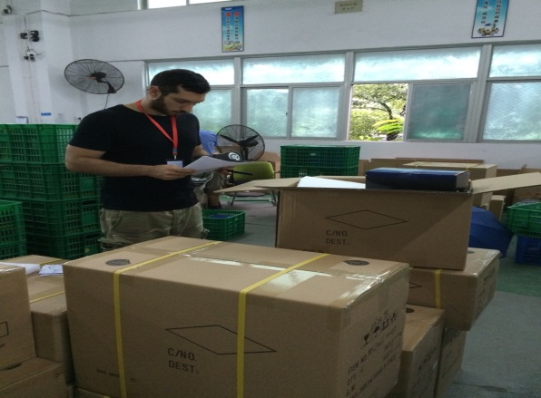
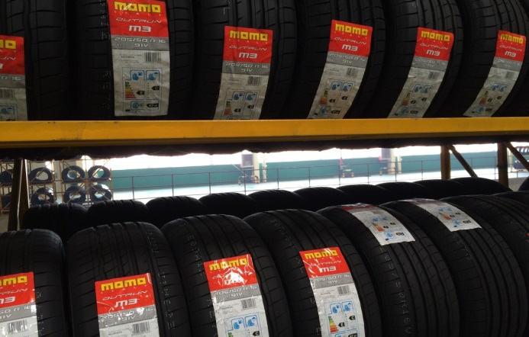

Slide 12
Conclusion
Voice of Customer
Strong Expertise in China to do International Business
Profitable operations with Forcemac
High Efficiency in Communication
Innovative Project Developments
Inside Out
Outside In
Sectorial Knowledge in Auto Industry
Purchasing high quality service and products Safely
Voice of Business

Slide 13
THANK YOU …

